Slide 1
JAVASCRIPT

Slide 2

Presenter
Rasool Naguru : I have been working in IT industry around 10 years. My Passion is towards building applications on SharePoint Platform ,Web designing and Data Migrations, Performance Tuning, Application Design and Architecture, etc.,.

Slide 3
Agenda
Overview of JavaScript
JavaScript Syntax
How to Add JavaScript to a Page
JavaScript Reserved Words
Data Types & Variables
Dialog Box's
Operators & Arrays
Conditional & Looping Statements
Functions (Return Values)
Embedding JavaScript
Forms and JavaScript
Events
Error Handling

Slide 4
Overview of JavaScript
JavaScript is the scripting language of the Web and works in all major browsers, such as Internet Explorer, Mozilla, Firefox, Netscape, Opera.
A JavaScript consists of lines of executable computer code.
A JavaScript is usually embedded directly into HTML pages.
Client-side scripting.
JavaScript code is case sensitive.
JavaScript statements end with a semi- colon ;
Everyone can use JavaScript without purchasing a license.

Slide 5
Are Java and JavaScript the Same?
NO!
Java and JavaScript are two completely different languages in both concept and design!
Java (developed by Sun Microsystems) is a powerful and much more complex programming language - in the same category as C and C++.
JavaScript / JScript
Different brands or/and different versions of browsers may support different implementation of JavaScript.
They are not fully compatible
JScript is the Microsoft version of JavaScript.

Slide 6

JavaScript Syntax
A JavaScript consists of JavaScript statements that are placed within the <script>... </script> HTML tags in a web page.
You can place the <script> tag containing your JavaScript anywhere within you web page but it is preferred way to keep it within the <head> tags.
The script tag takes two important attributes:
language: This attribute specifies what scripting language you are using. Typically, its value will be JavaScript.
type: This attribute is what is now recommended to indicate the scripting language in use and its value should be set to "text/ JavaScript ".

Slide 7
How to Put a JavaScript Into an HTML Page?
<html>
<body>
<script type="text/javascript">
document.write("Hello World!")
</script>
</body>
</html>

Slide 8
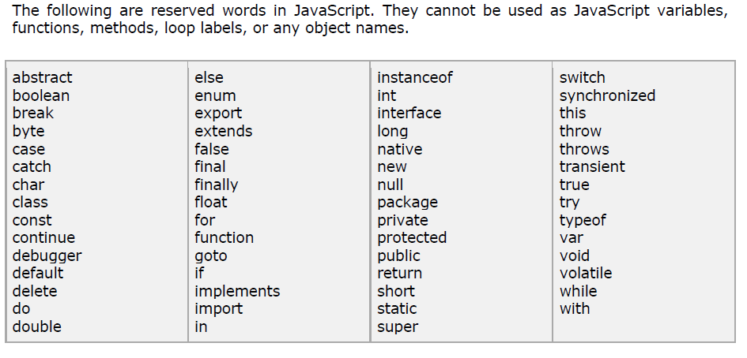
JavaScript Reserved Words

Slide 9
Comments in JavaScript
JavaScript supports both C-style and C++-style comments.
Any text between a // and the end of a line is treated as a comment and is ignored by JavaScript.
Any text between the characters /* and */ is treated as a comment. This may span multiple lines.

Slide 10
JavaScript Data Types
The type of values that can be represented and manipulated in a programming language.
JavaScript allows you to work with three primitive data types:
Numbers eg. 123, 120.50 etc.
Strings of text e.g. "This text string" etc.
Boolean e.g. true or false.
Special data types
Null: the only value is "null" – to represent nothing.
Undefined: the only value is "undefined" – to represent the value of an uninitialized variable

Slide 11
Null & Undefined
An undefined value is represented by the keyword "undefined".
It represents the value of an uninitialized variable
The keyword "null" is used to represent “nothing”
Declare and define a variable as “null” if you want the variable to hold nothing.
Avoid leaving a variable undefined.
var a;
if (a == undefined)
if (a == null)

Slide 12
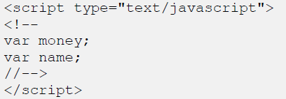
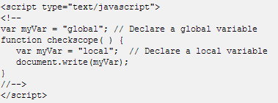
JavaScript Variables
JavaScript has variables. Variables can be thought of as named containers.
Variables are declared with the var keyword as follows:
Variable Scope:
Global Variables: A global variable has global scope which means it is defined everywhere in your JavaScript code.
Local Variables: A local variable will be visible only within a function where it is defined. Function parameters are always local to that function.

Slide 13
Dialog Box's
JavaScript supports three important types of dialog boxes.
These dialog boxes can be used to raise and alert, or to get confirmation on any input or to have a kind of input from the users.
Alert Dialog Box
Confirmation Dialog Box:
Prompt Dialog Box:

Slide 14
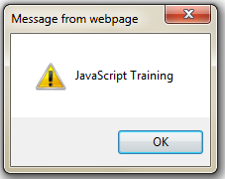
Alert Dialog Box
Mostly used to give a warning message to the users.
The syntax for an alert box is: alert("your text");
The user will need to click "OK" to proceed.

Slide 15
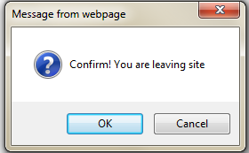
Confirmation Dialog Box
A confirmation dialog box is mostly used to take user's consent on any option. It displays a dialog box with two buttons: OK and Cancel.
If the user clicks "OK", the box returns the value true.
If the user clicks "Cancel", the box returns the value false.
The syntax for a confirm box is: confirm("your text");
var r=confirm("Confirm! You are leaving site");

Slide 16
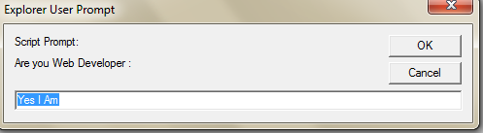
Prompt Dialog Box
The prompt dialog box is very useful when you want to pop-up a text box to get user input.
The prompt box syntax is: prompt("your text", "default value");
The user must click either "OK" or "Cancel" to proceed after entering the text.
If the user clicks "OK" the prompt box returns the entry.
If the user clicks "Cancel" the prompt box returns null.
prompt("Are you Web Developer : ", "Yes I Am");

Slide 17
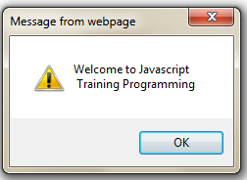
Line Breaks
Provide Line Breaks for Content.
alert("Welcome to JavaScript \n Training Programming");

Slide 18
Arrays
The Array object let's you store multiple values in a single variable.
var myArray = new Array(N);
var fruits = new Array( "apple", "orange", "mango" );
Index of array runs from 0 to N-1.
Can store values of different types
Property "length" tells the # of elements in the array.

Slide 19
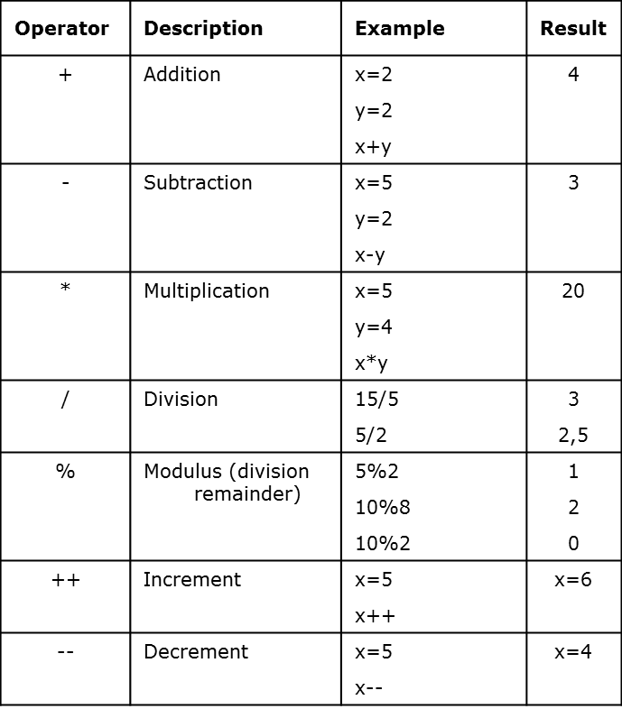

Operators
Arithmetic Operators

Slide 20
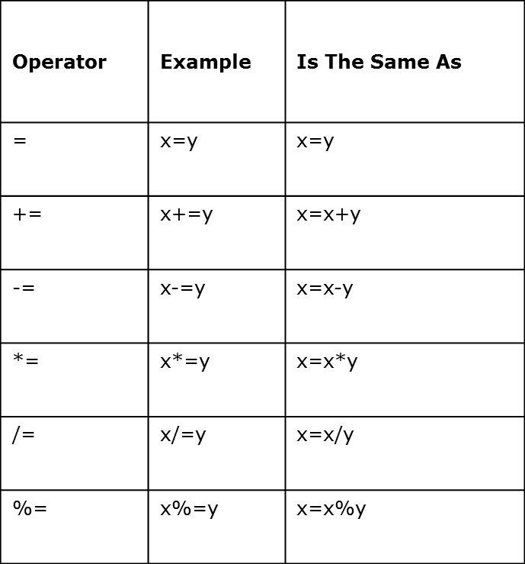
Assignment Operators

Slide 21
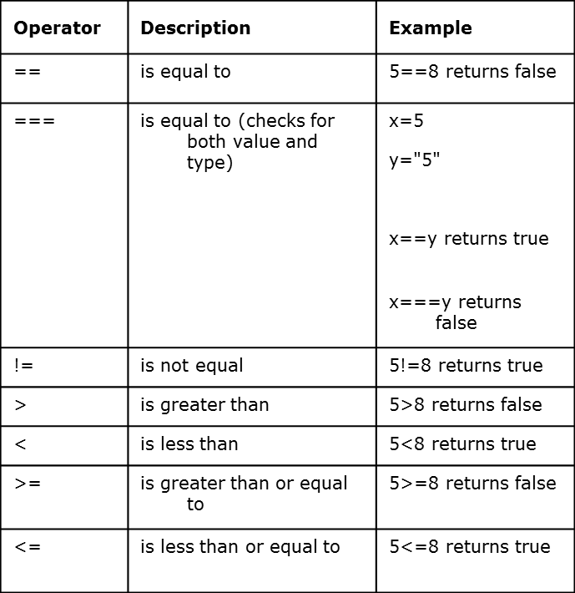
Comparison Operators

Slide 22
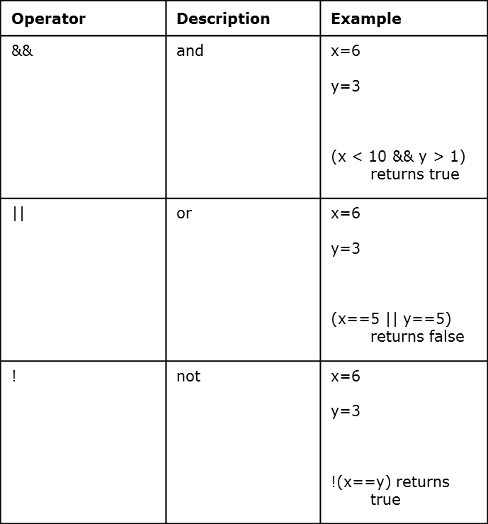
Logical Operators

Slide 23
Type of Operator
var x = "hello", y=true, z=123;
alert("Variable x value is " + typeof x );
alert("Variable y value is " + typeof y );
alert("Variable x value is " + typeof z );
An unary operator that tells the type of its operand.
Returns a string which can be "number", "string", "boolean", "object", "function", "undefined", and "null"
An array is internally represented as an object.

Slide 24

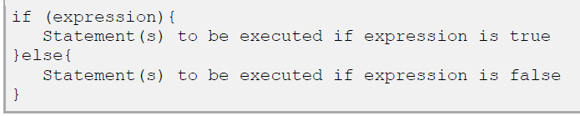
Conditional Statements
if statement
2. if...else statement

Slide 25
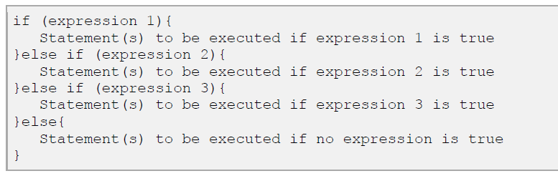
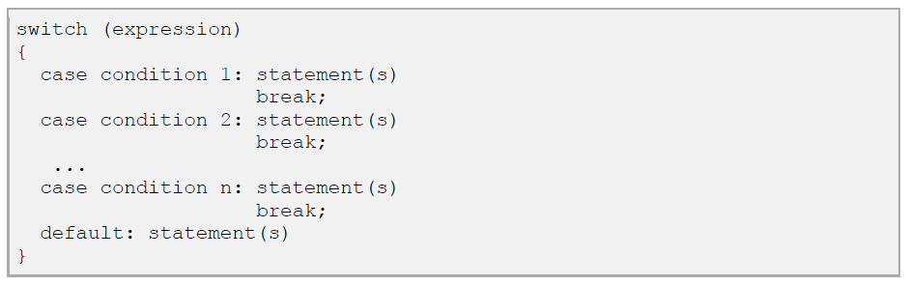
3. if...else if... statement
4. switch statement

Slide 26
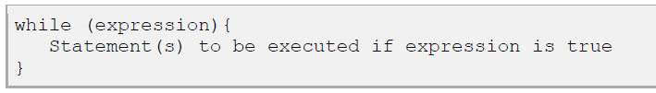

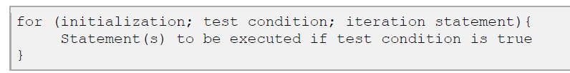
Looping Statements
1. while Loop
2. do...while Loop
3. for Loop

Slide 27
Functions (Return Values)
// A function can return value of any type using the
// keyword "return".
// The same function can possibly return values
// of different types
function foo (p1) {
if (typeof(p1) == "number")
return 0; // Return a number
else
if (typeof(p1) == "string")
return "zero"; // Return a string
// If no value being explicitly returned
// "undefined" is returned.
}
foo(1); // returns 0
foo("abc"); // returns "zero"
foo(); // returns undefined

Slide 28
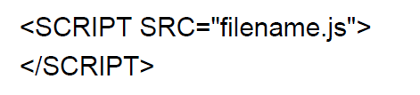
Embedding JavaScript
You can use the SRC attribute of the <SCRIPT> tag to call JavaScript code
from an external text file.
This is useful if you have a lot of code or you want to run it from several pages, because any number of pages can call the same external JavaScript file.

Slide 29
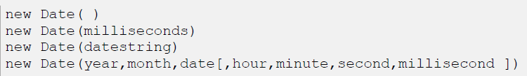
JavaScript - The Date Object
The Date object is a datatype built into the JavaScript language. Date objects are created with the new Date( )
Once a Date object is created, a number of methods allow you to operate on it.
Most methods simply allow you to get and set the year, month, day, hour, minute, second, and millisecond fields of the object, using either local time or UTC (universal, or GMT) time.

Slide 30
Forms and JavaScript
Textbox 5. Checkboxes
Password 6. Textarea
Dropdown menu 7. Buttons
Radio buttons
To get values for Form Input Fields by using following methods
document.getElementById('textbox_id').value
document.getElementsByName('name')[whole_number].value
Eg. document.getElementsByName("searchTxt")[0].value; if this is the first textbox with name 'searchtext' in your page.

Slide 31
Events
An event occurs as a result of some activity
e.g.:
A user clicks on a link in a page
Button click
Page finished loaded
Mouse cursor enter an area
A preset amount of time elapses
A form is being submitted

Slide 32
Event Handlers
Event Handler – a segment of codes (usually a function) to be executed when an event occurs
We can specify event handlers as attributes in the HTML tags.
The attribute names typically take the form "onXXX" where XXX is the event name.
e.g.:
<a href="…" onClick="alert('Bye')">Other Website</a>

Slide 33
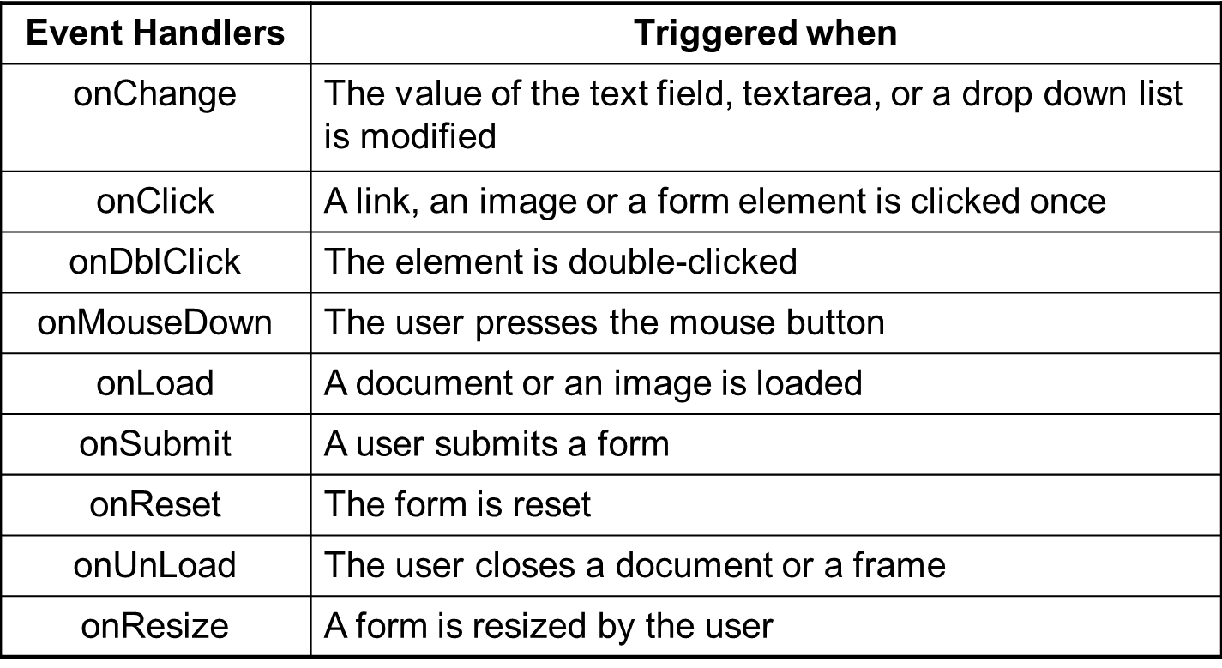
For a complete list, see http://www.w3schools.com/htmldom/dom_obj_event.asp

Slide 34
Hide Controls
You can hide Controls based on following conditions.
document.getElementById("Id").style.visibility = "visible"; // To Show
document.getElementById("Id").style.visibility = "hidden"; //To Hide
Or
var nResult = document.getElementById(‘id');
nResult.style.visibility = 'hidden';

Slide 35
Make Controls Readonly
To Make Controls Readonly using code
document.getElementById(“Id").readOnly = true; // To Readonly
document.getElementById(“Id").readOnly = false; //To UnReadonlyg

Slide 36
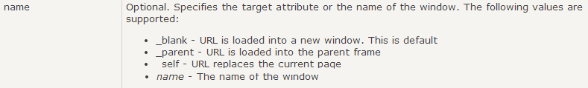
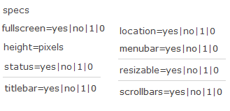
Windows Open & Close
Window.Open();
Syntax : window.open(URL, name, Specs);
Window.Close(); OR
top.close();
Syntax : window.Close();

Slide 37
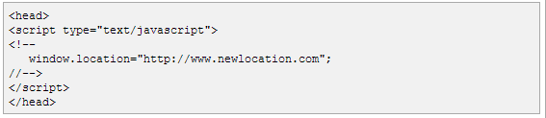
Page Redirection
This is very simple to do a page redirect using JavaScript at client side.
You can set Time interval for Redirection as well
setTimeout(‘url/function', ‘time’);
TO get current location address
document.location.href

Slide 38
Query String Parameters
You can Pass Variables from page to another page using following format.
Syntax : window.location.href = “url?variable=val“;
Example : window.location.href = “child.html?id=23“;
Use below function to read Query string Parameters or
You can use Split method to query string values
function getParameterByName(name) {
name = name.replace(/[\[]/, "\\\[").replace(/[\]]/, "\\\]");
var regex = new RegExp("[\\?&]" + name + "=([^&#]*)"), results = regex.exec(location.search); return results == null ? "" : decodeURIComponent(results[1].replace(/\+/g, " "));
}

Slide 39
Error and Exception Handling in JavaScript
JavaScript makes no distinction between Error and Exception (Unlike Java)
Handling Exceptions
The onError event handler
A method associated with the window object.
It is called whenever an exception occurs
The try … catch … finally block
Similar to Java try … catch … finally block
For handling exceptions in a code segment
Use throw statement to throw an exception
You can throw value of any type
The Error object
Default object for representing an exception
Each Error object has a name and message properties

Slide 40
How to use “onError” event handler?
<html>
<head>
<title>onerror event handler example</title>
<script type="text/javascript">
function errorHandler(){
alert("Error Ourred!");
}
// JavaScript is casesensitive
// Don't write onerror!
window.onError = errorHandler;
</script>
</head>
<body>
<script type="text/javascript">
document.write("Hello there;
</script>
</body>
</html>

Slide 41
try … catch … finally
try {
// Contains normal codes that might throw an exception.
// If an exception is thrown, immediately go to
// catch block.
} catch ( errorVariable ) {
// Codes here get executed if an exception is thrown
// in the try block.
// The errorVariable is an Error object.
} finally {
// Executed after the catch or try block finish
// Codes in finally block are always executed
}
// One or both of catch and finally blocks must accompany the try block.

Slide 42
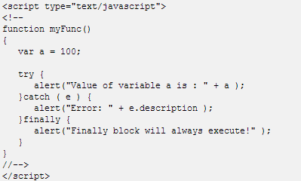
try … catch … finally example

Slide 43
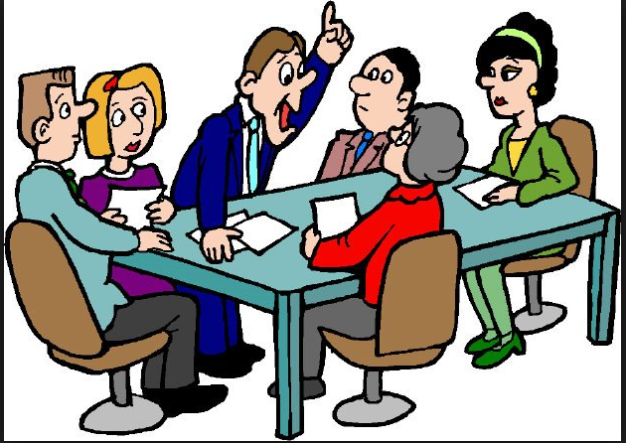
Q & A

Slide 44
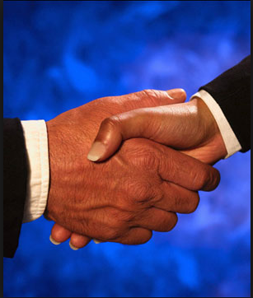
Thank You

